Slide 1

The Education of Looked After Children: what can foster carers do?
Fostering Potential Conference
4 March 2020
Judy Sebba
Rees Centre
University of Oxford, Department of Education
judy.sebba@education.ox.ac.uk

Slide 2
Why do children become looked after?
Notes:
78,150 (March 2019) children in care of which 72% are in foster care. In considering their education, it is important to take account of the abuse or neglect that occurred before they came into care

Slide 3
Some outcomes of children in care in England
Average ‘attainment 8’ (GCSE points for best 8) for children in care is 19 compared to 44 for all children – a gap of 25 between CiC and all children
Achievement gap significant at age 11 - 30% gap in reaching expected standard all 3 subjects, CiC 35%, all children 65%, but 58% identified SEN
Permanently exclusions of children in care decreased from 0.14% (2015) to 0.10% (2017). As rates for those not in care have increased, now same.
More than five times more likely to have fixed term exclusion (11.8% of LAC in 2017 compared to 2.3% of all children, both increased)
Of 27,220 former care leavers aged 19-21, 40% were not in education, employment or training
Only 6% (19-21 yr olds) access HE compared to > 50% of general population but 12% older care leavers in Harrison’s (2017)
Educational experiences and outcomes contribute to later health, employment (22% unemployment rate), involvement in crime (27% of those in prison)
DfE (2019) Outcomes for looked after children 31 March 2018

Slide 4


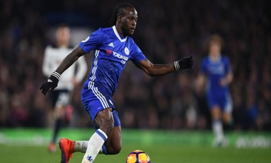
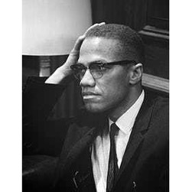

But many people who grow up in care do very well
Notes:
Victor Moses Chelsea – both parents murdered in Nigeria – sought asylum in England aged 11
Malcolm X
Neil Morrissey

Slide 5
^{Identity in school}
Like I said, no one barely, at school no one knows I’m in care, so they would never, ever, ever... I think, if they knew, it would be harder for me to just act like I weren’t. Like, it would be harder for me to focus on my education and stuff, because I’d constantly be thinking, ‘Oh...’ Like, you’d conform, I think. I think if people knew, like, what you were like as being a foster kid, and what everyone else is like as a foster kid, you’d conform, not even realising you were. But, I think where no one really knows, I actually see myself as not in care. Do you know what I mean? I actually see myself as normal, as the rest of my friends are, with parents, and stuff like that.
Notes:
Many studies have highlighted the reluctance of YP in care to identify themselves as such.

Slide 6
Structures to support children in care’s education
Virtual school – head is one of only 7 statutory roles in LA - support and challenge schools and key partners (e.g. foster carers, social workers) to get best outcomes.
Responsible for 0-25, also adopted and special guardianship
Designated teacher in each school has responsibility for helping school staff understand children in care and ensuring that the child has a voice
Personal Educational Plans (PEPs) to ensure progress
Pupil Premium Plus – currently £2300 – budget held by Virtual School – Ofsted inspect use for benefit of child

Slide 7

Education
Rees Centre/University of Bristol study, funded by The Nuffield Foundation
Linked national data sets on the education and care experiences of looked after children in English schools Year 11
Interviewed 26 young people (high- and lower- progress) in six local authorities and with their carers, teachers, social workers and Virtual School staff
http://reescentre.education.ox.ac.uk/research/educational-progress-of-looked-after-children/

Slide 8
Education
Of those in Year 11 in 2012-13:
4847 had been in care for at least a year
1387 had been in care less than a year
13,599 were ‘Children in Need’
There were 622,970 other young people

Slide 9
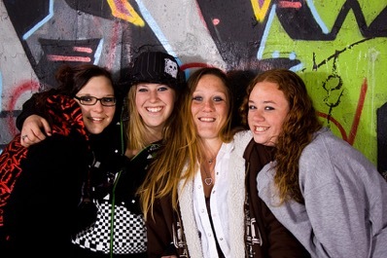
Education
Of the 4847 who were in care for at least a year:
Over half first entered care as teenagers
29% had been in most recent placement for under a year
17% had only ever had one placement
10% had had 10 or more placements since first entry to care

Slide 10
66% of the individual differences in GCSE scores is explained by these factors
EARLY ENVIRONMENT
CARE PLACEMENTS
FSM at KS1
Home language at KS1
Placement changes since KS2
Length of time in care
Home language at KS4
Placed out of authority at KS4
IDACI at KS1
Care career type
Length of latest placement
FSM at KS4
In non-foster placement at KS4
IDACI at KS4
INDIVIDUAL
RELATED TO SCHOOLING
Gender
Mean SDQ score
KS2 scores
School changes in Year 10-11
In non-mainstream school at KS4
Ethnicity
Primary SEN
Unauthorised absences
Fixed & permanent exclusions
Notes:
These are all the variables we included in the regression model for looked after children – next full-colour slide shows the significant predictors.

Slide 11
Which ones made a difference?
(‘significant predictors’)
EARLY ENVIRONMENT
CARE PLACEMENTS
Each change since KS2
-2.3 pts
Home language at KS4 not English
-18.8 pts
Disability
-18.2 pts
Each extra month in latest placement
+0.09 pts
Foster or kin placement KS4
+37.3 pts
INDIVIDUAL
RELATED TO SCHOOLING
Male
-7.6 pts
1 pt higher on SDQ
-1.7 pts
Each extra point in KS2 scores
(range 2.5-8.0)
+39.6 pts
Change in Year 10 or 11
-33.9 pts
Special -87.6 pts
PRU -88.2 pts
AP -121.4 pts
ASD -38.2 pts
MLD -10.4 pts
SMLD -87.6 pts
10% absence (unauthorised)
-25.5 pts
Each day excluded
-1.08 pts
Notes:
6 points is one GCSE grade

Slide 12
What does this mean for young people?
Children in long-term care did better than those who were ‘in need’ but not in care, and better than those who had been in care for under 12 months, so care seems to protect them
Young people in foster or kinship care at age 16 scored higher than those in residential or other placement types especially alternative provision
Young people who changed school during final two years scored over five grades less than those who didn’t
For every 5% of school sessions missed - unauthorised absences, young people scored two grades less
For every additional day of school missed due to fixed-term exclusions, young people scored one-sixth of a grade less
Schools that perform better with all children also show good progress for children in care
Notes:
What happened BEFORE they came into care that is important

Slide 13
Factors affecting educational outcomes
26 young people interviewed suggested important factors were:
key adult (not always teacher) in school ‘being there for them’
coming into care overwhelmingly seen as positive
foster carers’ level of educational support seemed more important than their educational qualifications – new analysis shows importance of aspirations of foster carers
YP’s control over the situation, emerged in ‘matching’ study
YP’s choice not to be identified as in care ‘being seen as normal’
interventions that supported them such as one-to-one tuition
long-term (negative) impact of responsibility for a birth parent affected by substance/alcohol abuse, mental illness

Slide 14
Continuing birth family influence
I remember the night before my English GCSE exam, she phoned me up, like, with suicide voicemails and everything, so it just made me lose a lot of focus, so I stopped having contact with her...like, I couldn’t go upstairs and revise English or anything, or do an essay, because I’d get worried that she would be...my mind would be on her and what she would be doing, like if she was going to threaten the people that I lived with, or me, or anything like that. So it made me lose a lot of focus and stuff, and got me quite anxious…so I couldn’t focus on anything else that I wanted to focus on. My mind was set somewhere else, so I wouldn’t have been able to focus very well.
Notes:
This young woman wanted to know why the social worker wasn’t looking after her mum rather than bothering her.
This burden of responsibility for vulnerable parents was often referred to by young people. It isolated them further from their peer group.

Slide 15

Reading Together:
The effectiveness of an enhanced book gifting intervention for improving reading outcomes for children in care
(ongoing, to be completed in August 2020)
Centre for Evidence and Social Innovation, Queen’s University Belfast
Rees Centre, University of Oxford

Slide 16
What we are trying to find out
Can book-gifting (over 6 months) be effective in improving the reading skills of 7- 9-year-old children in foster care, if supplemented with a clearly defined and enhanced role for the foster carer?
Can this enhanced role for the foster carer be supported through the provision of a handbook or does it also require face-to-face/ telephone training?
Measures include accuracy, rate, comprehension, vocabulary and attitudes to reading.
Interviewed 30 children and their carers before and after?

Slide 17
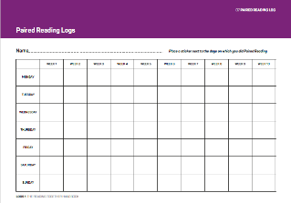
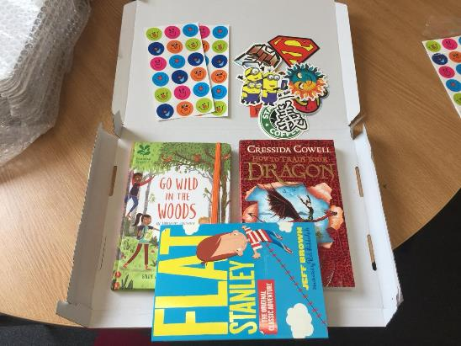

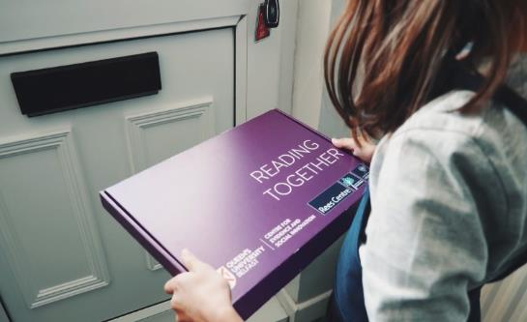
Intervention
260 children from 22 LAs randomised into 3 groups:
Group 1: books plus a handbook for foster carers; Group 2: books plus the handbook and training in paired reading for foster carers;
Group 3: a control group that get the books and handbook at the end.

Slide 18
Extract 1 from handbook
Paired
Reading

Slide 19
Extract 2 from Handbook

Slide 20
Findings from the pilot
10 children/FCs, 5 trained but 3 children moved, 5 handbook only
Children liked choosing the books and receiving the parcels
she was happy with what she’d chosen when they arrived, and she was really excited when the second parcel arrived (FC)
  Recognition of the support from carers
I could share like big words and {name of foster father} tells me them big words so then I’m very happy (YP)
  FCs noted that reluctant readers became more motivated
  That was a You Choose book, so she actually probably for the first time ever said “oh, I want to read this one again and see if I get a different outcome”...and she really ... she’d go “ah, died again. {laughs} Now I’ve got to go back to page nine”.

Slide 21
More findings from the pilot
  FCs were positive about the Handbook:
  Yes, I think if I was just given this book [handbook], because as foster carers, you get a lot of stuff to read, and half the time, you’re like, oh, my God, what’s this now? So, it is quite nice, actually, for it to be explained to you, and then given the book. Yes, I find that very helpful.
  And one suggested all parents at the school should receive it!
  FCs were positive about the training and voluntarily set up a What’s App group to give each other support on how the reading was going
  FCs reported improvements in children’s memory, fluency comprehension, learning about styles of writing, pronunciation and expression

Slide 22
What can foster carers do?
Seek support e.g. ‘Education Champions’, supervising social worker, to help you navigate the education system
Let the child know that you have high aspirations for them (at appropriate level) and try to acknowledge each achievement
Respect their wishes to be seen as ’normal’ but help them accept support
Try to respond in ways that get behind the behaviour e.g. ‘I can see you are angry’, let’s talk about it
Be assertive to get them into a ‘good’ school and to stay there e.g. when moving to you or from you, especially in last two years
Attend the PEP meeting (with support) and give your views (including their views) on what support they need e.g. laptop, one-to-one tuition, support for sports or to pursue hobbies, etc.
Acknowledge the role of a significant adult in school
Help the child develop a sense of belonging, friendship groups
Try to make sure the school consult you BEFORE excluding the child

