Slide 1
Maths, myths and mindsets Supporting children with maths skills

Slide 2
Agenda
Overview of numeracy in the UK
Our own attitudes about maths and why they matter for supporting children
The role of engagement in children’s maths learning and top tips for engaging positively with children’s maths
Some resources that can help
Q&A

Slide 3
Numeracy in the UK
49% of adults have the numeracy skills expected of children at primary school
Roughly 4 in 5 adults are working below Level 2 (below C/4 at GCSE)
Source: Department for Business Innovation and Skills. 2012. “The 2011 Skills for Life Survey: A Survey of Literacy and ICT Levels in England.”

Slide 4
A negative culture around maths

Slide 5
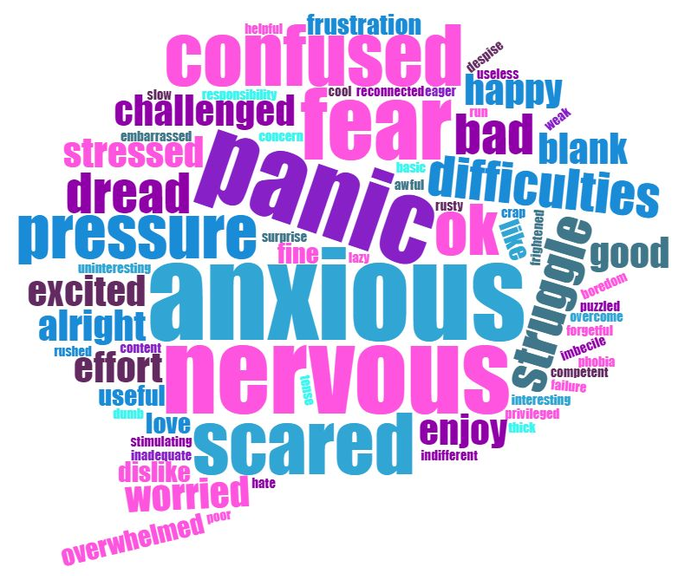
How do people feel about maths
When people explain why they feel this way – the reason usually comes from experiences as a child.

Slide 6
A new approach: its all about mindset
Value
Understand the value of maths in everyday life and recognise the benefits of improving numeracy
Recognise that ability is not fixed and develop a
‘can-do’ attitude
Belief
Effort
Recognise that everyone struggles in order to succeed – it’s part of the learning process

Slide 7
Myths about maths: if you believe them your children might too
Maths is not useful once you have your GCSE.
Boys are better at maths than girls.
Some people are naturally good at maths, others are not.
Nobody needs maths anymore because we have calculators and technology.
If someone is the bottom maths set, it means they are simply not good at maths and can’t improve.

Slide 8
Engagement in maths learning
“Involvement (from adults outside of school) has a large and positive impact on children’s learning” (Department for Education, 2010)
“The effect of parental involvement at home was stronger than that of either socio-economic status or guardians level of education” (Desforges and Abouchaar, 2003)

Slide 9
Tips for engaging positively
Talk positively about maths
Link maths to the everyday
Praise effort not “talent”
Boost your own skills

Slide 10
Our resources
For you
For children
nnchallenge.org.uk/fostering
familymathstoolkit.org.uk
For more information contact: ben@nationalnumeracy.org.uk

