Slide 1
Notes:
Good morning
My name is Michelle Sebele and I will be talking about my journey to medical school as care-experienced individual.
If you have any questions please feel free to ask during my presentation, I want this to be as interactive and informative as possible for you all. There will also be time allocated at the end of the presentation for questions.

Slide 2

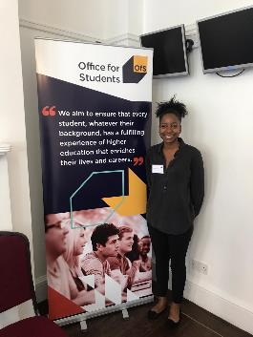
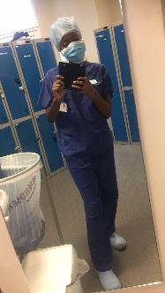
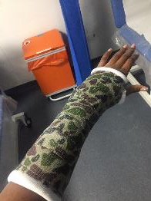
Life as a medical student
Recently completed my third year of MBBS at King’s College London (KCL) University
Infectious Diseases and Immunobiology (IBSc) September 2019 at KCL
Work part-time as an Outreach for Medicine Ambassador and Debate Mate Mentor
Voluntary roles as a Sutton Trust Alumni Leadership Board Member and Drive Forward Foundation Policy Forum Ambassador

Slide 3
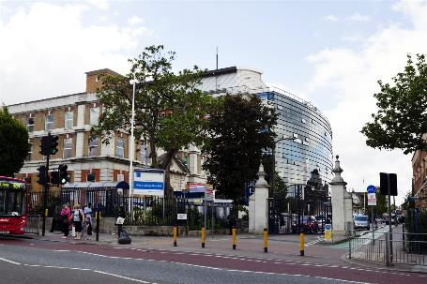
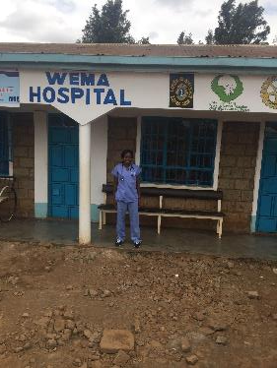
Life as a medical student
Extended Medical Degree Programme (EMDP) 6 years
MBBS2020 Curriculum
Pre-clinical (Years 1A,1B and 2)
Clinical (Years 3,4,5)
Monday | Tuesday | Wednesday | Thursday | Friday
Hospital placement (KCH) | Scholarly Project Module | Doctor as Teacher | Hospital Placement (KCH) | Longitudinal Psychiatric Placement
Notes:
Positives and negatives:
Use of knowledge to solve real life problems
Using problem solving skills to diagnose a patient is very fun. A bit like solving a puzzle, putting all the symptoms, signs and history together to get a bigger picture of what is going on.
Honorable role, patient’s trust you and allow you to help them. (I assisted in a C-section delivery in my second year)
Huge responsibility dealing with patients lives which can be challenging but is immensely enjoyable
Negatives:
Duration of degree→ constantly studying
Long hours and dedication to career leaves little time for socialising
Can be very stressful (exam periods, working with patients)
What does an average week look like?
Positives and negatives!
Best parts/highlights so far

Slide 4

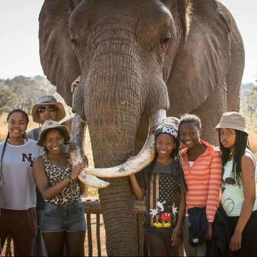
My background
Entered the care system at the age of 5
Looked after by WSCC but placed in South West London
Attended a state primary and secondary school
Involvement with student council , sports teams, peer-mentoring and homework club.
NFA Award for Academic Progress 2013
Participated in Realising Opportunities (Year 12), Sutton Trust Summer School/ Pathways to Medicine (2014)
Clouddog Volunteering Programme 2014
Harris Federation Student of the Year Award for Academic Excellence (2014)
Notes:
Fortunate because I had a fairly stable education and didn’t move from home to home.
Helped foster strong relationships and sense of identity
Allowed me to focus on school, being a kid because I wasn’t burdened with having to get to know new people at school or at home.
Location of school was close to home. Easy to commute to and from and helped me feel like I belonged.
PRIMARY:
English was my second language and I struggled immensely with learning it. I still struggle sometimes till this day. I did experience difficulties ’fitting in’ at the beginning because of the language barrier.
What could be done to help children? Reading and Comprehension. My foster carers would force me to read every evening aloud for 30-45 minutes whilst cooking. I would also have to do comprehension exercises alongside my homework. Maths: Timestable CD played in the car and played when getting ready for school and bed. I had educational posters and books. Although my foster carers did not come from an academic background they did push academia in the household.
Good contact between social workers, foster carers and school. I felt I was able to express my concerns about my learning in school. Assistance for Mathematics at school. Important for schools to pick this up early on and give students the support needed.
Years 7-9:
Important for students to explore. I took part in every afterschool club, field trip or opportunity made available. I was able to see what I liked and what I didn’t enjoy so much.
Competed in netball, athletics, rounders, basketball and academic competitions.
Built a good rapport with teachers.
Years 9-11
-GCSEs are the primary focus. 5 A*-C including English and Mathematics. It is so important for care experienced children to get the GCSE grades in order to access HE and increasing earning potential. 23% of looked after children achieve 5 good GCSES vs 60% other pupils.
What to do to help:
Get students extra tuition if they need it
Stable home, stable child= stable education.
Get students the mental health support they need.
PEP reviews are controversial so assess the needs and wants of the child to see how useful they are.
Homework club→ afterschool, local libraries etc.
Additional work done alongside homework is important.
School holidays → Play schemes and had tasks to do as well. Reading, maths etc.
Sixth Form/College
Stayed on at secondary school for Sixth Form because I was familiar with teachers and felt well settled.
A-levels (3 A-levels and 1 AS)

Slide 5

Applying to medical school
Important to start considering HE from a young age
Careers Advisors
UCAS application and personal statement
Work experience/Volunteering
BMAT/UKCAT
Interview (MMI or Panel)
Notes:
Open up a dialogue with young people about future aspirations so that they can start working towards that. Goal mapping is so important. Many students do not know what they want to do but start looking at areas they enjoy and are good at.
Carers advisors can be helpful in giving students information about HE such as grade requirements, A-levels. Can be hit or miss. Do not rely solely on this.
UCAS application opens early September
UCAS deadline for Medicine, Dentistry, Veterinary Sciences, Oxbridge is earlier than other courses. Usually 15th October. 15th Jan for other courses
Tick the care-related questions in your UCAS application. This is important for you to do this so that the admissions team at your designated universities are aware of your background and can provide support (if available) in your pre-application/post-application. Some universities, such as King’s, will take extra consideration for students applying from a care leavers background (Contextualised admissions). If you can also incorporate that you are a care leaver in your personal statement, I would recommend you do so. This will help the admission teams to identify you and provide you with more support. If you are not comfortable with this idea, you can ask your teachers to reference your care leaver background in their UCAS reference for you.
Strong references is important
Work experience→ can be a nightmare to get! Go on Hospital pages and find list of Drs email addresses and email as many as possible asking for WE.
If not see if you can volunteer in your local hospital, helping feed patients and assisting nurses. As this will give you an opportunity to talk to doctors.
Volunteer in a nursing home, Age UK, charity shop if you cannot find anywhere else.
Duration of work experience is not important it is being able to reflect on your experience and how that has helped you decide that medicine is the correct course for you.
They want to see you have understood what it means to be a doctor.
Challenges: Achieving the grades, personal statement and deadlines (not having someone from a medical background/who has experience in medical applications to really help).
Keeping momentum. Feels like there are many obstacles/hurdles in your pathway. One thing after another but keep pushing!
GCSE’s
- GCSE grade 6/B or above in English Language and Mathematics before applying. 5A*-C GCSEs in Eng and Maths (9-5)
A-levels → Must take Biology and Chemistry at A-level plus another subject e.g. Maths, Physics, English. Some universities will not accept certain subjects as a 3rd A-level so check entry requirements.
IB (if school offers)

Slide 6
What has been helpful?
UCAS and SFE (Please tick the ‘box’)
Online resources (Propel, Become, Buttle UK and Which?)
Education on HE (Student Finance, bursaries and scholarships, support for care leavers and housing)
Apply to Widening Participation programmes such as HELOA, RO, K+, Kings of King’s, Sutton Trust and Nuffield Health
Attend university open days
Bursaries and Scholarships
Notes:
Propel→ Website launched by BECOME for care experienced children to access full information about each institution’s pastoral and financial provision for care leavers, as well as inspirational stories from care-experienced students.
Become→ Charity for children in care and young care leavers. Offer life coaching and free advice line for care-experienced children or care leavers.
Buttle UK→ financial support for children experiencing hardship.
Education on HE: myth busters about paying for university, what the loan means, when is it paid back etc. Financial support available to young people (bursaries and scholarships). Use propel and contact universities directly.
HELOA: Is the professional association for access, recruitment and outreach staff working in Higher Education in the UK. Its mission is to support and enable its members to help students make informed decisions. Run care-experienced days which are very informative for children in care, carers and social workers.
Realising Opportunities: unique collaboration of leading, research intensive universities, working together to promote fair access and social mobility of students from groups underrepresented in higher education. 2 year programme. Students benefit from increased information, advice and access to some of the country’s leading research intensive universities. Students accepted on to RO follow a programme which ensures they are better equipped for university life and what research intensive universities can offer.
Realising Opportunities gave me my first exposure to university. The RO ementoring portal provided continuous support throughout my application to study medicine. My ementor gave me tailored information and recommendations for UCAS application, Student Finance, student accommodation, budgeting and socialising which I had not had access to.
At university:
Accommodation- 51 week contracts
Financial support (bursaries for care-leavers)
Personal tutors (pastoral support)
Friends (such an amazing support system)

Slide 7
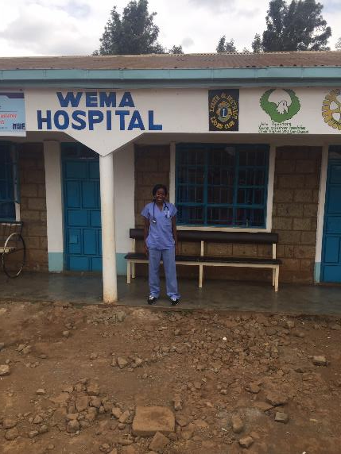
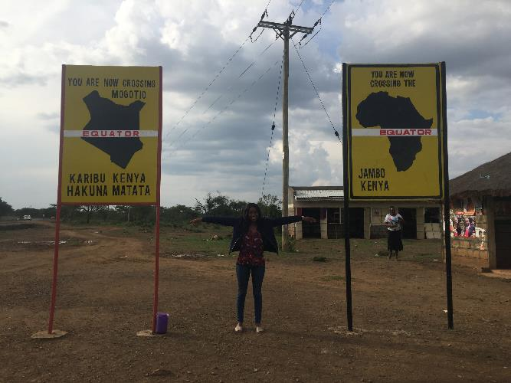
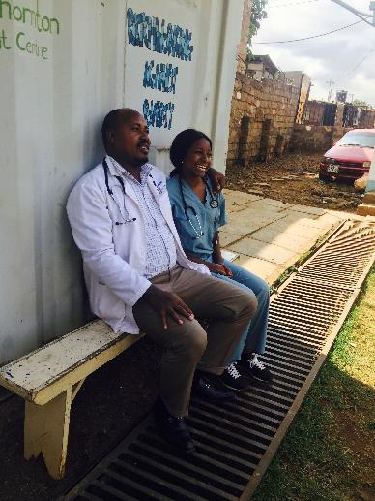
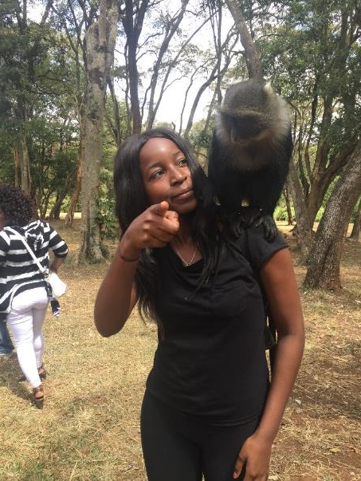

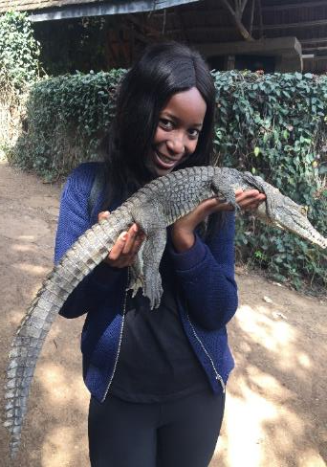
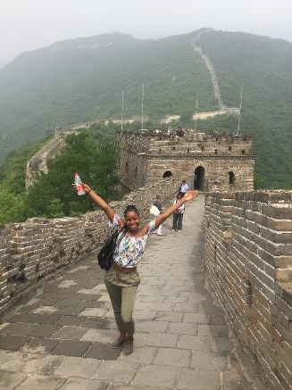
Final words
Notes:
Interested in Medical Genetics, Infectious Diseases and Immunology
Continuing my work on social mobility
Teaching
Advice to young person aged 16 considering medicine → There will be times when you feel like giving up and that it is just a pipe dream, pick yourself up and keep pushing. If I can do it, so can you!

Slide 8

Thank you – any questions?
www.thefosteringnetwork.org.uk
Member helpline: 0207 401 9582

Slide 9
Links
https://www.suttontrust.com/
http://www.realisingopportunities.ac.uk
https://propel.org.uk/UK/
https://www.kcl.ac.uk/study/undergraduate/courses/extended-medical-degree-programme-mbbs
https://becomecharity.org.uk
https://university.which.co.uk
http://www.unitefoundation.co.uk/wp-content/uploads/2019/01/2019_20_Information-and-Guidance.pdf

